Slide 1
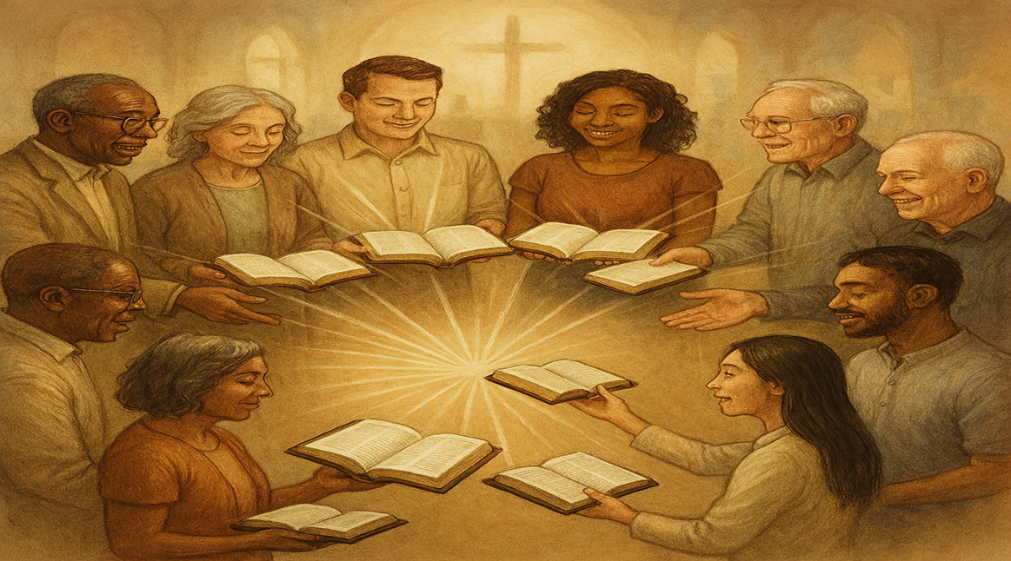
The Church Goes and Tells Everyone About
JESUS
and HIS
CHURCH
Acts 8:4

Slide 2
Scripture 1 (version)
Trebuchet MS (Body)
Minimum size = 54
Transition beginning of scripture = Doors
Transition subsequent pages = Page Curl

Slide 3
Scripture 1 (version)
Trebuchet MS (Body)
Minimum size = 54
Transition beginning of scripture = Doors
Transition subsequent pages = Page Curl

Slide 4
Scripture 2 (version)
Trebuchet MS (Body)
Minimum size = 54
Transition beginning of scripture = Doors
Transition subsequent pages = Page Curl

Slide 5
TITLE
Three Points
Point
Point
Point

Slide 6
Commentary: (if needed)
Calibri 54 minimum
(example)How do you listen to preaching? It will affect your life. If you neglect or reject preaching, God will hate and reject your prayers.

Slide 7
Commentary:
If God is against everything you do, including your prayers, no amount of effort will work.
Here is one of the most important proverbs.

Slide 8
Point #1: Point title
Scripture (version)
Scripture (version)

Slide 9
Scripture 1 (version)
Trebuchet MS (Body)
Minimum size = 54
Transition beginning of scripture = Doors
Transition subsequent pages = Page Curl

Slide 10
Scripture 1 (version)
Trebuchet MS (Body)
Minimum size = 54
Transition beginning of scripture = Doors
Transition subsequent pages = Page Curl

Slide 11
Scripture 1 (version)
Trebuchet MS (Body)
Minimum size = 54
Transition beginning of scripture = Doors
Transition subsequent pages = Page Curl

Slide 12
Scripture 2 (version)
Trebuchet MS (Body)
Minimum size = 54
Transition beginning of scripture = Doors
Transition subsequent pages = Page Curl

Slide 13
Scripture 2 (version)
Trebuchet MS (Body)
Minimum size = 54
Transition beginning of scripture = Doors
Transition subsequent pages = Page Curl

Slide 14
Point #2: Point title
Scripture (version)
Scripture (version)

Slide 15
Scripture 1 (version)
Trebuchet MS (Body)
Minimum size = 54
Transition beginning of scripture = Doors
Transition subsequent pages = Page Curl

Slide 16
Scripture 1 (version)
Trebuchet MS (Body)
Minimum size = 54
Transition beginning of scripture = Doors
Transition subsequent pages = Page Curl

Slide 17
Scripture 1 (version)
Trebuchet MS (Body)
Minimum size = 54
Transition beginning of scripture = Doors
Transition subsequent pages = Page Curl

Slide 18
Scripture 2 (version)
Trebuchet MS (Body)
Minimum size = 54
Transition beginning of scripture = Doors
Transition subsequent pages = Page Curl

Slide 19
Scripture 2 (version)
Trebuchet MS (Body)
Minimum size = 54
Transition beginning of scripture = Doors
Transition subsequent pages = Page Curl

Slide 20
Point #3: Point title
Scripture (version)
Scripture (version)

Slide 21
Scripture 1 (version)
Trebuchet MS (Body)
Minimum size = 54
Transition beginning of scripture = Doors
Transition subsequent pages = Page Curl

Slide 22
Scripture 1 (version)
Trebuchet MS (Body)
Minimum size = 54
Transition beginning of scripture = Doors
Transition subsequent pages = Page Curl

Slide 23
Scripture 1 (version)
Trebuchet MS (Body)
Minimum size = 54
Transition beginning of scripture = Doors
Transition subsequent pages = Page Curl

Slide 24
Scripture 2 (version)
Trebuchet MS (Body)
Minimum size = 54
Transition beginning of scripture = Doors
Transition subsequent pages = Page Curl

Slide 25
Scripture 2 (version)
Trebuchet MS (Body)
Minimum size = 54
Transition beginning of scripture = Doors
Transition subsequent pages = Page Curl

Slide 26

…that Christ died for our sins according to the scriptures;
And that he was buried, and that he rose again the third day according to the scriptures:

Slide 27
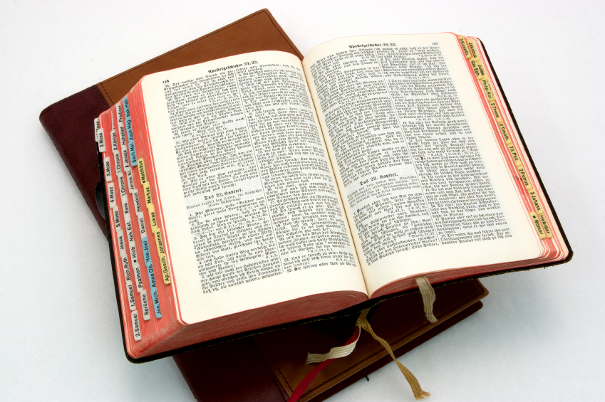
Hear: Romans 10:17
So then faith cometh by hearing, and hearing by the word of God.

Slide 28
Believe: Hebrews 11:6
But without faith it is impossible to please him: for he that cometh to God must believe that he is, and that he is a rewarder of them that diligently seek him.

Slide 29
Repent: Luke 13:3
I tell you, Nay: but, except ye repent, ye shall all likewise perish.

Slide 30
Confess: Matthew 10:32-33
32 Whosoever therefore shall confess me before men, him will I confess also before my Father which is in heaven.
33 But whosoever shall deny me before men, him will I also deny before my Father which is in heaven.

Slide 31
Baptize: Acts 22:16
And now why tarriest thou? arise, and be baptized, and wash away thy sins, calling on the name of the Lord.

